Slide 1

Hands-On Ethical Hacking and Network Defense,
Edition 4
Module 13: Network Protection Systems
Simpson, Antill, Wilson, Hands-On Ethical Hacking and Network Defense, 4th Edition. © 2023 Cengage. All Rights Reserved. May not be scanned, copied or duplicated, or posted to a publicly accessible website, in whole or in part.

Slide 2
Module Objectives
By the end of this module, you should be able to:
  Explain how routers are used as network protection systems
  Describe firewall technology and tools for configuring firewalls and routers
  Describe intrusion detection and prevention systems and web-filtering technology
  Explain the purpose of honeypots

Slide 3
Using Network Protection Systems
Network protection system
  Any device or system designed to protect a network
Unified Threat Management (UTM) device
  Term used to describe a single device that combines many network protection functions
    Such as those performed by routers, firewalls, intrusion detection and prevention systems, VPNs, web-filtering systems, and malware detection and filtering systems
Security appliance
  Can describe both UTMs and network protection systems

Slide 4
Using Routers to Reduce Network Attacks
Routers are hardware devices
  Used to send packets to different network segments
  Main purposes
    Reduce broadcast traffic passing over a network
    Choose the best path for moving packets
Routing protocols
  Link-state routing protocol
    Sends link-state advertisements to other routers
  Distance-vector routing protocol
    Router passes its routing table to neighboring routers on the network
  Path-vector routing protocol
    Uses dynamically updated paths or routing tables to transmit packets from one autonomous network to another

Slide 5
Cisco Router Components (1 of 2)
Random access memory (RAM)
  Holds the router’s running configuration, routing tables, and buffers
    If turned off, contents stored in RAM are erased
Nonvolatile RAM (NVRAM)
  Holds router’s configuration file
    Information is not lost if the router is turned off
Flash memory
  Holds the Internetwork Operating System (IOS) the router is using
  Rewritable memory, so IOS can be upgraded

Slide 6
Cisco Router Components (2 of 2)
Read-only memory (ROM)
  Contains a minimal version of Cisco IOS
    Used to boot router if flash memory gets corrupted
Interfaces
  These components are the hardware connectivity points to the router
    The components you’re most concerned with
Basic Cisco commands
  A security professional should be aware of the basic Cisco commands
    To view information in the Cisco router components
  Example: RouterB# show running-config
    To see what information is stored in RAM, a Cisco administrator uses the command above

Slide 7
Cisco Router Configuration (1 of 2)
Configuration modes:
  User mode
    Administrator can perform basic troubleshooting tests and list information stored on the router
    Indicated by the router name followed by a > symbol
    When first logging on to a Cisco router, you’re in user mode by default
  Privileged mode
    Administrator can perform full router configuration tasks
    Indicated by a router name followed by a # sign

Slide 8
Cisco Router Configuration (2 of 2)
Modes to configure the router in privileged mode
  Global configuration mode
    Administrator can configure router settings that affect overall router operation
  Interface configuration mode
    Administrator can configure an interface on the router, such as a serial port

Slide 9
Cisco Commands (1 of 3)
Mode | Command | Prompt | Description
Privileged or user | show version | Router# or Router> | Displays the router’s version information, including the IOS version number
Privileged or user | show ip route | Router# or Router> | Displays the router’s routing table
Privileged or user | show interfaces | Router# or Router> | Lists configuration information and statistics for all interfaces on the router
Privileged or user | show flash | Router# or Router> | Shows the contents of flash memory and the amount of memory used and available
Privileged | show running-config | Router# | Displays the currently running router configuration file

Slide 10
Cisco Commands (2 of 3)
Mode | Command | Prompt | Description
Privileged | show running-config | Router# | Displays the currently running router configuration file
Privileged | show startup-config | Router# | Displays the contents of NVRAM
Privileged | copy running-config startup-config | Router# | Copies the running configuration to NVRAM so that changes made are carried out the next time the router is started
Privileged | copy startup-config running-config | Router# | Copies the startup configuration from NVRAM to memory (RAM)
Global configuration (privileged) | configure terminal | Router (config)# | Enables you to change configuration settings that affect overall router operation

Slide 11
Cisco Commands (3 of 3)
Mode | Command | Prompt | Description
Interface configuration (privileged) | interface serial | Router (config-if)# | Enables you to configure the serial interface you identify, such as serial 0
Interface configuration (privileged) | interface fastethernet | Router (config-if)# | Enables you to configure the Fast Ethernet interface you specify

Slide 12
Using Access Control Lists
Several types of access control lists
  This section focuses on IP access lists
  IP access lists: Lists of IP addresses, subnets, or networks that are allowed or denied access through a router’s interface
An administrator can create two types of access lists on a Cisco router
  Standard IP access lists
  Extended IP access lists

Slide 13
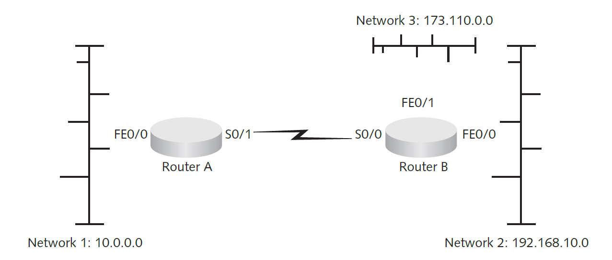
Standard IP Access Lists
Can restrict IP traffic entering or leaving a router’s interface based on source IP address
  To restrict all traffic from Network 3 from entering Network 1, an administrator can create a standard IP access list that looks like:
      access-list 1 deny 173.110.0.0 0.0.255.255
      access-list permit any

Slide 14
Extended IP Access Lists
Restrict IP traffic entering or leaving based on the following criteria:
  Source IP address
  Destination IP address
  Protocol type
  Application port number
Configuration
  Same as configuring a standard IP access list
    A network administrator can decide which interface to apply an access list to, based on several variables

Slide 15
Knowledge Check Activity 13-1
Which type of routing protocol advertises only new paths to other routers on the network?
Link-state routing protocol
Routing table protocol
Path-vector routing protocol
Distance-vector routing protocol
Notes:
Instructions:
Use the Knowledge Check questions to periodically pose a question to students during class to gauge how well they can recall the material that was presented.

Slide 16
Knowledge Check Activity 13-1: Answer
Which type of routing protocol advertises only new paths to other routers on the network?
Answer: a. Link-state routing protocol
A link-state routing protocol sends link-state advertisements to other routers; these advertisements identify the network topology and any changes or paths discovered recently on the network. This method is efficient because only new information is sent over the network

Slide 17
Polling Activity 13-1
Which of the following Cisco components stores a router’s running configuration, routing tables, and buffers?
a. NVRAM
b. RAM
c. ROM
d. Flash memory
Notes:
Instructions:
1. Use this activity to solicit student opinions about concepts in the module or to play a game.
2. Go to kahoot.com, or the platform of your preference, and log in or sign up.
3. Create the challenge.
4. Teacher Tip: Turn off the timer to prioritize accuracy or turn on the nickname generator to avoid inappropriate nicknames.
5. Invite players by sharing the link or PIN.
6. This can be done synchronously during class or asynchronously for review or homework.

Slide 18
Polling Activity 13-1: Answer
Which of the following Cisco components stores a router’s running configuration, routing tables, and buffers?
Answer: b. RAM
The RAM holds the router’s running configuration, routing tables, and buffers.

Slide 19
Protecting with Firewalls (1 of 2)
Firewalls
  Hardware devices with embedded OSs
  Software installed on general-purpose computer systems
Firewalls serve two main purposes
  Control access to traffic entering an internal network
  Control traffic leaving an internal network
Advantages of hardware firewall
  Usually faster than software firewalls
  Can handle a larger throughput than software firewalls
Disadvantage of hardware firewall
  Locked into the firewall’s hardware

Slide 20
Protecting with Firewalls (2 of 2)
Advantage of software firewall
  Can add network interface cards (NICs) easily to the server running the software
Disadvantages of software firewall
  Configuration problems can be a concern
  Rely on the OS on which they’re running

Slide 21
Examining Firewall Technology
Technologies used by firewalls in reducing attacks
  Network Address Translation (N A T)
  Access lists
  Packet filtering
  Stateful packet inspection (SPI)
  Application layer inspection

Slide 22
Network Address Translation
The most basic security feature of a firewall
Internal private IP addresses are mapped to public external IP addresses
  Hides the internal infrastructure from unauthorized personnel
Port Address Translation (PAT)
  Derived from N A T
  Allows thousands of internal IP addresses to be mapped to one external IP address

Slide 23
Access Lists
Used to filter traffic based on:
  Source IP address
  Destination IP address
  Ports or services
Firewalls also use this technology
Creating access lists on a firewall
  Similar to creating them on a router

Slide 24
Packet Filtering
Packet filters
  Screen packets based on information contained in the packet header, such as the following:
    Protocol type
    IP address
    TCP/UDP port

Slide 25
Stateful Packet Inspection
Stateful packet filters
  Record session-specific information about a network connection, including a state table
    State table is a way for the firewall to track the state of connections
      Based on what kind of traffic is expected in a two-way session
    Port scans relying on spoofing or sending packets after a three-way handshake are made ineffective if the firewall uses a state table
    Recognize types of anomalies that most routers ignore
Stateless packet filters
  Handle each packet on an individual basis
    Hence, not resistant to spoofing or DoS attacks

Slide 26
State Table Example
Source IP | Source port | Destination IP | Destination port | Connection state
10.1.1.100 | 1022 | 193.145.85.201 | 80 | Established
10.1.1.102 | 1040 | 193.145.85.1 | 80 | Established
10.1.1.110 | 1035 | 193.145.85.117 | 23 | Established
192.145.85.20 | 1080 | 10.1.1.210 | 25 | Closed

Slide 27
Application Layer Inspection
Application-aware firewall
  Inspects network traffic at a higher level in the OSI model than a traditional SPI firewall does
    SPI ensures that a packet’s source, destination, and port are inspected before forwarding the packet
    A firewall performing application layer inspection ensures that the network traffic’s application protocol is the type allowed by a rule
  Some application-aware firewalls act as a proxy for all connections
    Act as a safety net for servers or clients (or both)
      Depending on what the firewall is protecting
    Web application firewall (WAF)
      An application-aware firewall that is protecting a web application

Slide 28
Implementing a Firewall
Using a single firewall between a company’s internal network and the Internet can be dangerous
  Provides hackers complete access to the internal network if the firewall is compromised
Use a demilitarized zone (DMZ) instead
  Adds a layer of defense

Slide 29
Demilitarized Zone (1 of 3)
Small network containing resources that a company wants to make available to Internet users
  Helps maintain security on the company’s internal network
Sits between the Internet and the internal network
  Sometimes referred to as a “perimeter network”

Slide 30
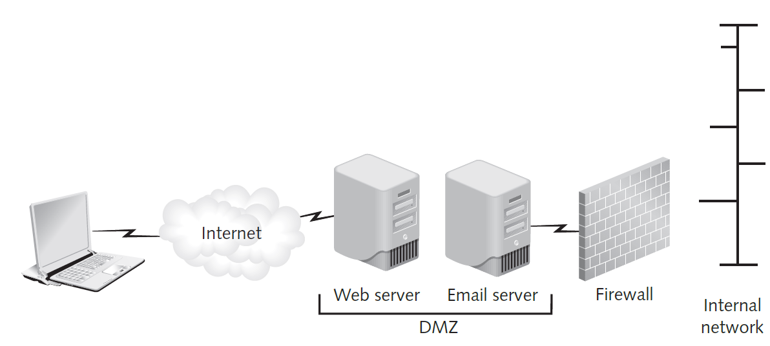
Demilitarized Zone (2 of 3)
Figure 13-2 A DMZ protecting an internal network

Slide 31
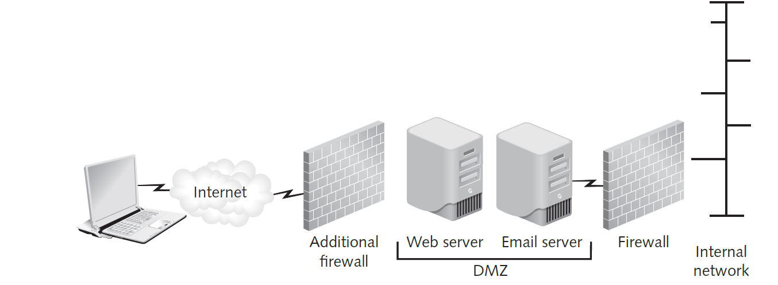
Demilitarized Zone (3 of 3)
Figure 13-3 An additional firewall used to protect the DMZ

Slide 32
Examining the Cisco Adaptive Security Appliance Firewall
Cisco Adaptive Security Appliance (A S A) firewall
  One of the most widely used firewalls
  Replaced the Cisco PIX firewall
  Added advanced modular features
    Intrusion detection and prevention
    More sophisticated application layer inspection

Slide 33
Configuring the A S A Firewall (1 of 2)
Similar logon prompt as a Cisco router
  Prompt
  If you are not authorized to be in this XYZ Hawaii network device, log out immediately!
  Username: admin
  Password: ********
    The banner warning serves a legal purpose
  Prompt after successful log on
  Type help or '?' for a list of available commands.
  ciscoasa>

Slide 34
Configuring the A S A Firewall (2 of 2)
After entering the correct password, you are placed in a privileged mode
To enter configuration mode in A S A:
  Use the same command as on a Cisco router
  configure terminal or configure t
Look at how the firewall uses access lists to filter traffic
  To view access list type, use the following command:
  # show run access-list
  Next, look at the object group listing in the A S A configuration
  show run object-group

Slide 35
Using Configuration and Risk Analysis Tools for Firewalls and Routers (1 of 3)
Center for Internet Security (C I S)
  One of the best websites for finding configuration benchmarks and configuration assessment tools
Benchmark
  Industry consensus of best configuration practices on how and why to secure a Cisco router or firewall
    For Cisco devices, use the C I S Cisco IOS Benchmark
    The most recent version is 16.0
C I S offers a useful tool called Configuration Assessment Tool (C A T)
  Faster and easier to use
  Available for both *nix and Windows systems

Slide 36
Using Configuration and Risk Analysis Tools for Firewalls and Routers (2 of 3)
RedSeal
  A unique network risk analysis and mapping tool
  Can identify configuration vulnerabilities in routers or firewalls
  Generates professional-looking reports that can be customized
  Analyzes IPSs and OS vulnerability scans of a network
    To produce detailed analysis and mapping
  Shows a graphical representation of vulnerabilities discovered in the context of the network on which they are found

Slide 37
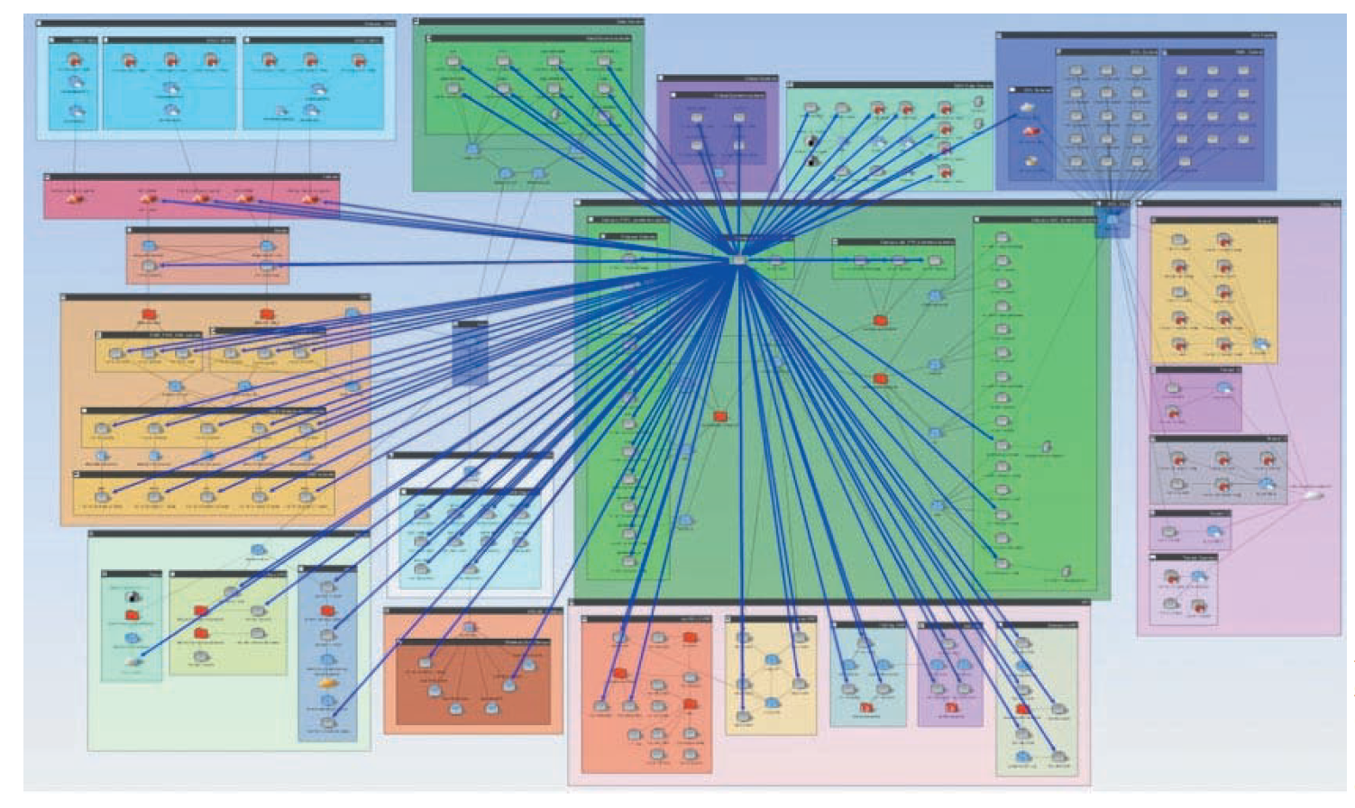
Using Configuration and Risk Analysis Tools for Firewalls and Routers (3 of 3)
Source: RedSeal
Figure 13-4 The RedSeal network risk map

Slide 38
Polling Activity 13-2
Firewalls use which of the following to hide the internal network topology from outside users?
Packet filtering
SPI
ACL
N A T
Notes:
Instructions:
1. Use this activity to solicit student opinions about concepts in the module or to play a game.
2. Go to kahoot.com, or the platform of your preference, and log in or sign up.
3. Create the challenge.
4. Teacher Tip: Turn off the timer to prioritize accuracy or turn on the nickname generator to avoid inappropriate nicknames.
5. Invite players by sharing the link or PIN.
6. This can be done synchronously during class or asynchronously for review or homework.

Slide 39
Polling Activity 13-2: Answer
Firewalls use which of the following to hide the internal network topology from outside users?
Answer: d. N A T
The most basic security feature of a firewall is Network Address Translation (N A T). With N A T, internal private IP addresses are mapped to public external IP addresses, hiding the internal infrastructure from unauthorized personnel.

Slide 40
Protecting with Intrusion Detection and Prevention Systems
Intrusion detection systems (IDSs)
  Monitor network devices
    Security administrators can identify attacks in progress and stop them
  Examine the traffic traversing a connection and compares it with known exploits
    Similar to virus software using a signature file to identify viruses
Intrusion prevention systems (IPSs)
  Similar to IDSs
  Also perform some sort of action to prevent the intrusion

Slide 41
Network-Based and Host-Based IDSs and IPSs (1 of 4)
Network-based IDSs/IPSs
  Monitor activity on network segments
  Sniff traffic as it flows over the network
    Alerts security administrator when something suspicious occurs
  Some of these systems can block traffic
Host-based IDSs/IPSs
  Used to protect a critical network server or database server
  The IDS or IPS software is installed on the system you’re attempting to protect

Slide 42
Network-Based and Host-Based IDSs and IPSs (2 of 4)
IDSs can also be categorized by how they react when they detect suspicious behavior
  Passive systems
    Don’t take preventative action
    Send out an alert and log the activity
  Active systems
    Log events and send out alerts
    Can also interoperate with routers and firewalls to stop an attack

Slide 43
Network-Based and Host-Based IDSs and IPSs (3 of 4)
Vendors have started focusing their marketing efforts on IPSs
  A true network-based IPS is installed inline to network infrastructure
    Traffic has to pass through IPS before going into or out of the network
  More capable of stopping malicious traffic because it is inline
  Host-based IPSs operate at the OS (or kernel) level
    Intercept traffic that is not allowed by the host policy

Slide 44
Network-Based and Host-Based IDSs and IPSs (4 of 4)
Anomaly-based IDS
  Uses a baseline of normal activity
    Sends an alert if the activity deviates significantly from this baseline
  Most IDS/IPS solutions have anomaly-detection capabilities built in
Product | Description
McAfee Network Protection System | A network-based IDS/IPS with anomaly-detection capabilities
Snort | A popular open-source network-based IDS
Cisco Sourcefire | Enterprise Snort-based IDSs and IPSs
FireEye Intrusion Prevention System | A network-based IDS/IPS which can be deployed as a physical appliance or a cloud-based virtual appliance.

Slide 45
Web Filtering (1 of 2)
Attackers commonly target the user workstations that are usually allowed access to the Internet
  If they get an internal user to visit a bogus website or install malicious code from an email attachment, they don’t need to break through a firewall
  After Trojan code is installed on a user’s workstation, the attackers can control the Trojan remotely with commands that might seem to be normal traffic
    Can run network scans from the compromised workstation

Slide 46
Web Filtering (2 of 2)
Web filtering is used to detect users’ attempts to access known malicious websites and block them
  Some web-filtering systems can actually block malicious code:
    Before it gets to a user’s workstation
    Before it has a chance to connect to an attacker’s control system outside the network
Mass compromises are used to initiate drive-by downloads
  Website visitors download malicious code without their knowledge
  Exploit a security flaw in the browser or a third-party application

Slide 47
Security Operations Center (SOC)
SOC
  Permanent team whose members are responsible solely for security-response functions
Indicators of compromise
  Artifacts left behind by attackers, which indicate that a system or network has been compromised
Security Information and Event Management (SIEM) tools
  Help SOC teams identify attacks and indicators of compromise by collecting, aggregating, and correlating log and alert data from various tools
    Routers, firewalls, IDS/IPS, end point logs, web-filtering devices, honeypots, and other security tools

Slide 48
Knowledge Check Activity 13-2
Which of the following describes a tool that collects logs and alerts from multiple devices for security analysis?
Log Management System (LMS)
Security Information and Event Management (SIEM)
Network-based IPS
Honeypot
Notes:
Instructions:
Use the Knowledge Check questions to periodically pose a question to students during class to gauge how well they can recall the material that was presented.

Slide 49
Knowledge Check Activity 13-2: Answer
Which of the following describes a tool that collects logs and alerts from multiple devices for security analysis?
Answer: b. Security Information and Event Management (SIEM)
SIEM is a tool that can help security-response teams identify attacks and indicators of compromise by collecting, aggregating, and correlating log and alert data from routers, firewalls, IDS/IPS, end point logs, web-filtering devices, honeypots, and other security tools.

Slide 50
Discussion Activity 13-1
Discuss which type of malicious activity can be prevented by web filters.
Notes:
Instructions:
Use the Discussion activity to encourage group conversation about a related topic of interest.

Slide 51
Discussion Activity 13-1: Answer
Discuss which type of malicious activity can be prevented by web filters.
Answer: Drive-by download
Explanation: In 1988, the National Security Agency (NSA) thought the Data Encryption Standard (DES) was at risk of being broken because of its longevity and the increasing power of computers. NSA proved to be correct in its assumption. The increased processing power of computers soon made it possible to break DES encryption.

Slide 52
Using Honeypots
Honeypot
  Computer placed on the network perimeter
    Contains information to lure and then trap hackers
  Main goal is to distract hackers from attacking legitimate network resources
  A security professional configures the computer to have vulnerabilities
    So, hackers spend time trying to exploit these vulnerabilities
  Another goal is to have hackers connected to the “phony” computer long enough to be detected
  Serves as an excellent data collector and early warning system

Slide 53
How Honeypots Work
Honeypot appears to have important data or sensitive information stored on it
  Could store fake financial data that tempts hackers into attempting to browse through the data
Basic belief is that hackers will spend time exploiting vulnerabilities
  Stop looking for other areas to exploit and access a company’s resources
Enables security professionals to collect data on attackers
Virtual honeypots
  Created using a programming language rather than configuring a physical device

Slide 54
Self-Assessment
What is the main goal of using honeypots?
Describe the different routing protocols used in the best-path decision making process.
Notes:
Instructions:
Use the Self-Assessment question to encourage students to evaluate their progress or goals in the course, as well as determine how they might apply their learning or grow as an individual.

Slide 55
Summary
Now that the lesson has ended, you should be able to:
  Explain how routers are used as network protection systems
  Describe firewall technology and tools for configuring firewalls and routers
  Describe intrusion detection and prevention systems and web-filtering technology
  Explain the purpose of honeypots

